Slide 1
C Language Presentation: Calculator

Slide 2
Problem Statement
Analysis
CONTENTS
Design
Implementation
Test

Slide 3
Problem Statement
1
The problem of current calculators

Slide 4
Problem Statement
There are a lot of calculators we can find at present.
Some of them are too simple to do the calculation more than addition, subtraction, multiplication and division.
Some of them such as matlab are too complicated that they are not quite user-friendly and take plenty of time to run.
We hope to create a software that can not only fullfill the functions we need but also be easy and efficient to run.

Slide 5
Analysis
2
Analysis of the purpose and tasks

Slide 6
Analysis
Our calculator is intended to implement the following functions:
Basic calculation of addition, subtraction, multiplication and division. Parentheses are allowed in the prosess of calculation.
Calculation of the basic elementary functions.
Linear equations with any number of unknowns.
The calculation about statistics.
Definite integral.
A beautiful and plain interface

Slide 7
Design
3
Our plan of the program

Slide 8
Start
Input expression;
Select in the menu
Basic&
Function Calculation
Linear Equation
Statictical Calculation
Input coefficient matrix and constant matrix
Get&analyse the expression
Input&create a linked list
Calculate dete-
rminant&Solve
Do the calculation
Traverse and calculate
Convert the result to a string
Output the
result
End

Slide 9
Implementation
4
How to implement the functions

Slide 10
1:Implementation of Graphical User Interface
Use API(Application Programming Interface)
Set entry function WINMAIN（）
Sets the window class structure
RegisterClass()
CreateWindow()
ShowWindow()
Setting window procedure
Set WindowText

Slide 11
1: Implementation of Graphical User Interface
Stat
Input
N
if the buttons
were clicked
wait
Y
GetWindowText()
Convert to char
analysis&operate
Converts the result to a long string
output
End

Slide 12
2: Implementation of basic arithmetic operations
To change nifix expression to postfix expressin
An algorithm: Polish algorithm
Two core things
A structure: stack
To store every elements of expressions

Slide 13
3: Implementation of basic functional opperations
Definite integration
Functional evaluation
Substitute the value of x
Basic arithmetic opperations

Slide 14
4: Implementation of statistics
Pointer: head->NULL
Pointer: p
p->value = the value users input
p->next = NULL
Value/values
A pointer: next to the next unit
If p is the first: head = p

Slide 15
4: Implementation of statistics
If p is the first not the first:
Find the last and connect p to it
Pointer: last
(=head)

Slide 16
4: Implementation of statistics
If p is the first not the first:
Find the last and connect p to it
Pointer: last

Slide 17
4: Implementation of statistics
If p is the first not the first:
Find the last and connect p to it
Let last->next = p
Pointer: last

Slide 18
5: Implementation of Calculating a determinant to solve a linear equation
1x1 Determinant
return
return function itself
nxn Determinant
Each M is a smaller determinant

Slide 19
6: Implementation of other things
Find false
The other two things
Translate a number to binary system or octonary system

Slide 20
Test
5
The operation and test of our program

Slide 21
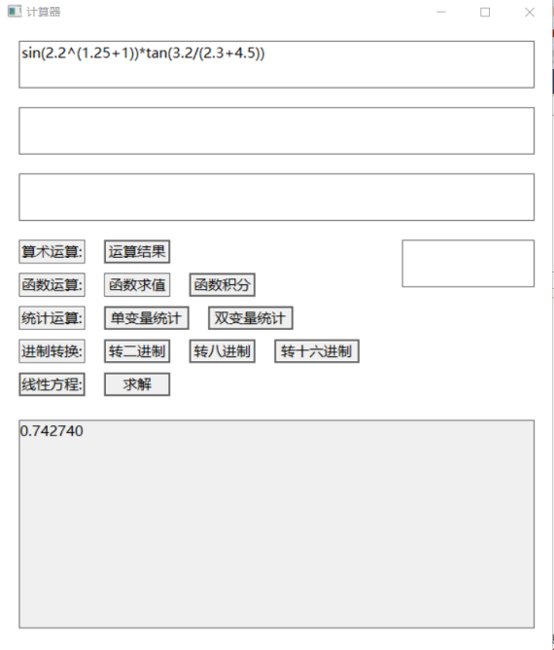
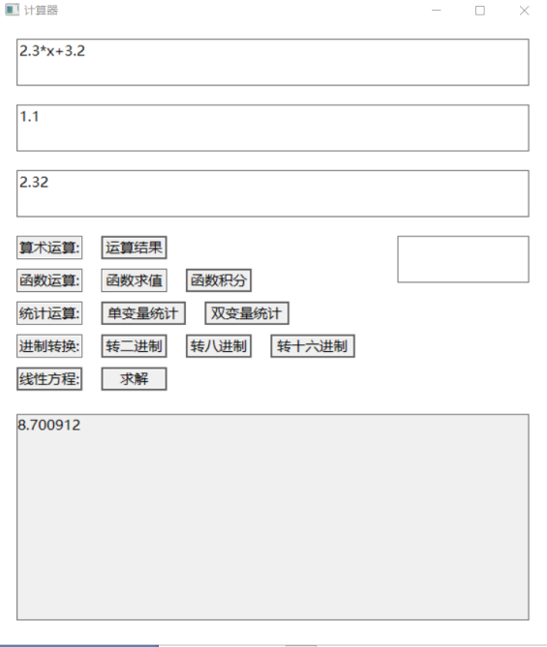
Definite integration
Basic arithmetic operations

Slide 22
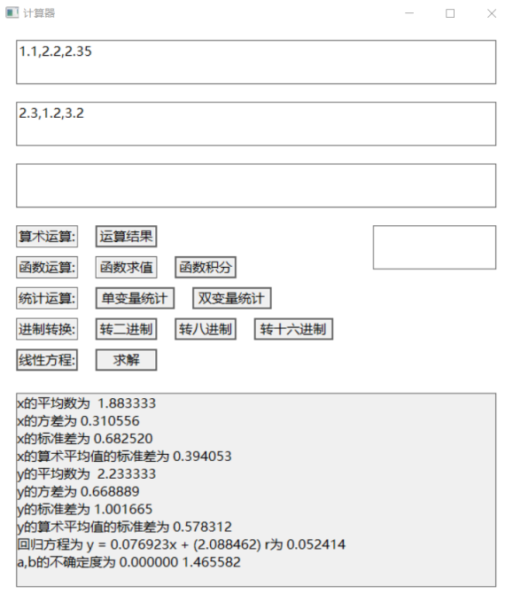
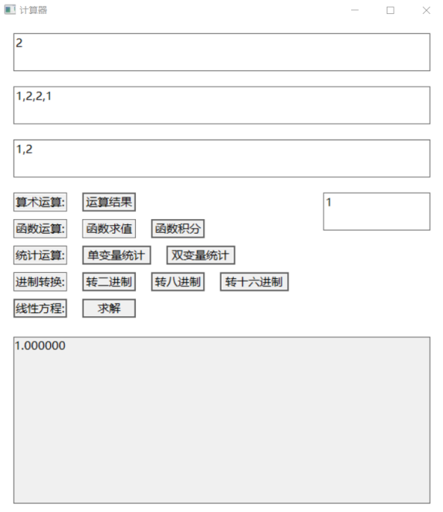
Linear equations
Bivariate statistics

Slide 23
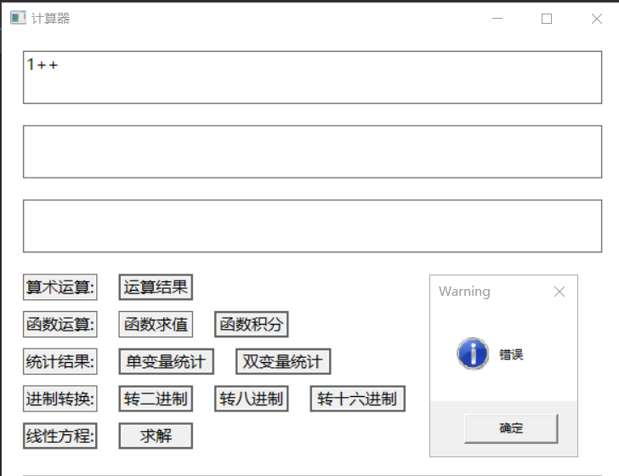
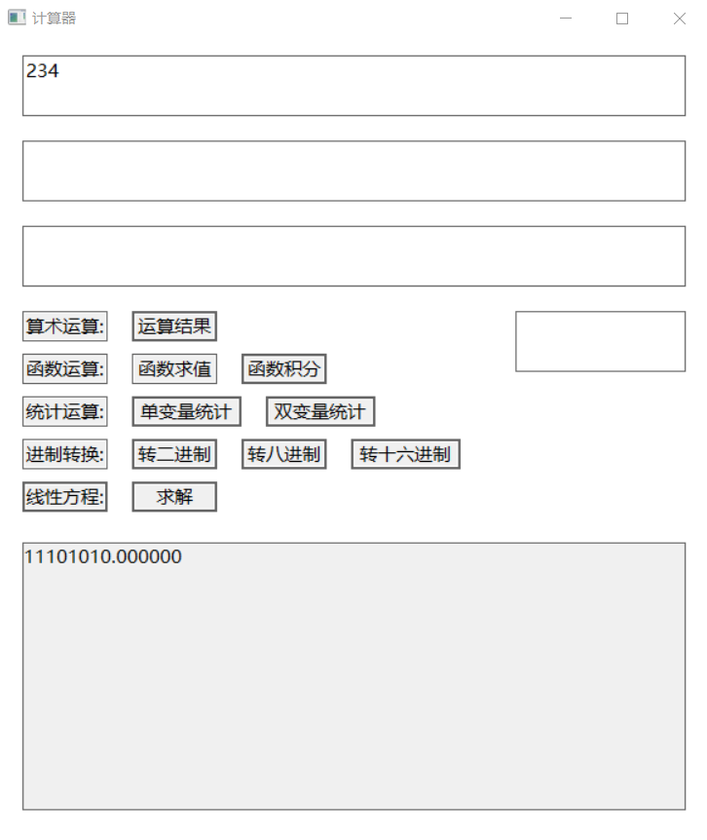
Translate to binary system
Find false

Slide 24
Thanks for listening!

